Slide 1
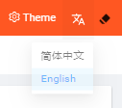
Overview
Route 1
Route 2 & 3
2022.12.27 10:34am
KANBAN UTILIZATION RATE (%)
TOTAL ONLINE CART QUANTITY (Route 1,2&3) | TOTAL ONLINE CART QUANTITY (Route 1,2&3)
Route | Target Online Cart | Actual Online Cart
1 | 79 | 45
2 & 3 | 130 | 95
Total | 209 | 140
Route 1
WHQ Empty Cassette Zone | Post WHQ Zone | Post DFF Zone | Post SE Zone | Route 1 : Empty Cart Zone | Route 1 : Dynamic
50%
50%
50%
50%
50%
50%
80%
80%
80%
80%
80%
80%
0
100%
0
0%
(30/0)
100%
0
0%
(16/0)
100%
0
24%
(29/7)
100%
0
100%
0
0%
(11/0)
100%
83%
(24/20)
78%
(18/14)
Route 2 |  | Route 3 | Route 3
Post APL Zone | APL Empty Cart Zone | Post OXI Zone | Post BPA Zone | Post PCV Zone | Route 3 : Dynamic (OXI) | Route 3 : Dynamic (PCV)
50%
50%
50%
50%
50%
50%
50%
80%
80%
80%
80%
80%
80%
80%
0
100%
100%
100%
100%
50%
(38/19)
0
68%
(22/15)
100%
0
0
25%
(32/8)
0
34%
(50/17)
0
0%
(0/0)
100%
0
0%
(0/0)
100%
45%
(42/19)

Slide 2
Overview
Route 1
Route 2 & 3
2022.12.27 10:34am
KANBAN UTILIZATION RATE (%)
TOTAL ONLINE CART QUANTITY (Route 1) | TOTAL ONLINE CART QUANTITY (Route 1,2&3)
Route | Target Online Cart | Actual Online Cart
1 | 79 | 45
Route 1
WHQ Empty Cassette Zone | Post WHQ Zone | Post DFF Zone
Route 1 : Dynamic | Post SE Zone | Route 1 : Empty Cart Zone
Total Kanban Quantity (Route 1) = 128
50%
50%
50%
80%
80%
80%
83%
(24/20)
0
0%
(30/0)
100%
0
100%
0
100%
0%
(16/0)
50%
50%
50%
80%
80%
80%
0
100%
0
100%
0
100%
0%
(11/0)
24%
(29/7)
78%
(18/14)

Slide 3
Overview
Route 1
Route 2
Route 3
2022.12.27 10:34am

Slide 4
Overview
Route 1
Route 2 & 3
2022.12.27 10:34am
KANBAN UTILIZATION RATE (%)
TOTAL ONLINE CART QUANTITY (Route 2 & 3) | TOTAL ONLINE CART QUANTITY (Route 1,2&3)
Route | Target Online Cart | Actual Online Cart
2 & 3 | 130 | 95
Route 2 |  | Route 3 | Route 3
Post APL Cart Zone | APL Empty Cart Zone | Post OXI Zone | Post BPA Zone | Post PCVD
 |  | Route 3 : Dynamic (OXI) | Route 3 : Dynamic (PCV)
Total Kanban Quantity (Route 2&3) = 207
50%
50%
50%
50%
50%
80%
80%
80%
80%
80%
50%
(38/19)
68%
(22/15)
45%
(42/19)
25%
(32/8)
34%
(50/17)
0
100%
0
100%
0
100%
0
100%
0
100%
50%
50%
80%
80%
0
0%
(14/0)
100%
0
0%
(9/0)
100%

Slide 5
Summary
Route 1
Route 2
Route 3
2022.12.27 10:34am

Slide 6
Summary
Route 1
Route 2
Route 3
2022.12.27 10:34am

Slide 7
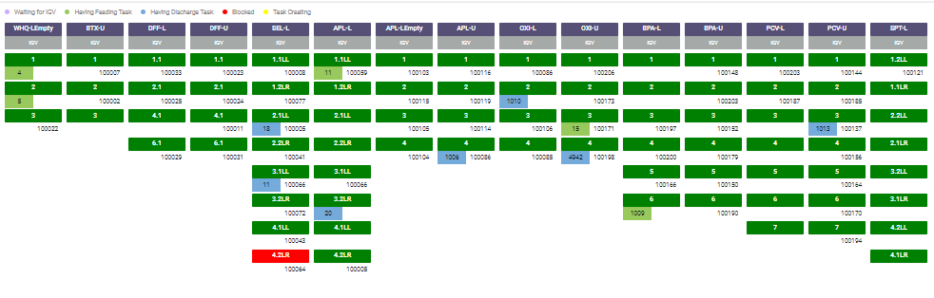
Docking Status
Route 1
Route 2
Route 3
2022.12.27 10:34am

Slide 8
Dashboard Layout Features
Selectable auto refresh rate for items below:
Each page able to update data without refreshing the whole page – 1 to 3600 seconds
Page transition – 1 to 3600 seconds
Selectable dashboard display sequence in individual display on Andon TV
User can manually edit target cart quantity for each Route 1 , 2 & 3 in system and data in each dashboard page get updated automatically
User can download history data for online cart at each Route 1, 2 & 3 in system
To display current date and time in each dashboard layout
For total online cart at each route , it displays 3 colors categories as followed:
Green : > = 90% of total cart quantity in each Route 1 , 2 & 3
Orange : > = 80% && <90% of total cart quantity in Route 1 , 2& 3
Red : < 80% of total cart quantity in Route 1 , 2& 3
User able to select language for dashboard layout display in English or Chinese
When user creates new parking zone, system will automatically include the parking zone details and update automatically in the dashboard layout or user can add parking zone into dedicated Route 1, 2 or 3 in dashboard layout
User able to select date range to download history data for each dashboard layout and all the downloaded data presented in graph format

